Slide 1
Lecture 4: determining serostatus and estimating seroprevalence
May 22, 2025
Seroanalytics Training Blantyre, Malawi

Slide 2
Lecture outline
How to choose a cutoff method
Sensitivity and specificity
Apply different methods for cutoffs
ROC curves
Mean + SD of negative controls
Mixture model

Slide 3
Cutoff methods
There isn’t always a clear answer for how to chose cutoff methods
Today we will go through 4 methods for determining a cutoff:
Externally-defined correlate of protection (covered this morning)
Receiver Operating Characteristic curve (ROC, based on sensitivity and specificity, using both positive and negative controls)
Unexposed population (negative controls)
Finite mixture model (FMM; only based on sample results)
Notes:
We are going to go through other cutoff methods today, and there isn’ t always a clear cut answer for how to choose the method. It can depend on what controls you have available. Today we’ll focus on 4 methods:

Slide 4

Examples of choosing cutoff methods
Serosurveillance of viral and vaccine-preventable diseases using 47-plex assay
Notes:
https://www.medrxiv.org/content/10.1101/2024.04.26.24306413v1
Investigation of the sero-epidemiology of vaccine preventable diseases and common viral infections in French populations using a multiplex serological assay

Slide 5
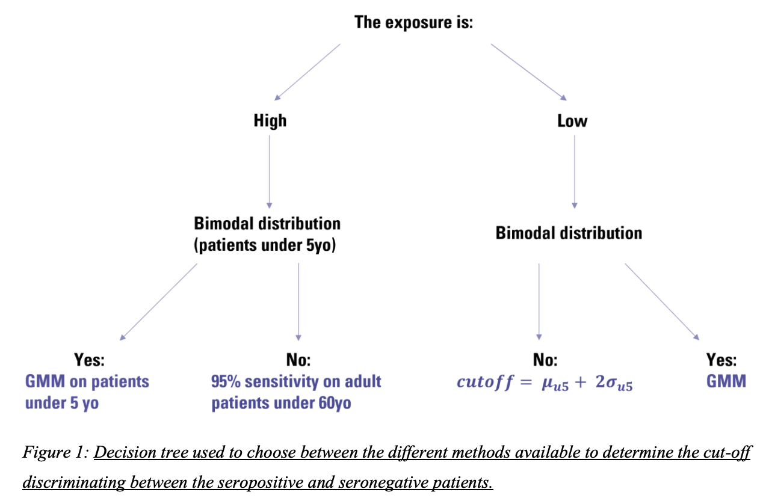
Examples of choosing cutoff methods
Bloch et al. Investigation of the sero-epidemiology of vaccine preventable diseases and common viral infections in French populations using a multiplex serological assay. 2024. medRxiv.
Notes:
https://www.medrxiv.org/content/10.1101/2024.04.26.24306413v1
Investigation of the sero-epidemiology of vaccine preventable diseases and common viral infections in French populations using a multiplex serological assay

Slide 6
Examples of choosing cutoff methods
Are international standards available (like for correlate of protection)?
Yes
No
Use international standard
Are positive and negative controls available?
No
Yes
Are negative controls available?
Use ROC curve; is Youden’s J reasonable?
Yes
No
Are negative controls normally distributed?
Use finite mixture model
Yes
No
Maximize Youden’s J
Maximize specificity with sensitivity ≥ 75%
Yes
No
Mean + 3SD of negative controls
Highest negative control
Example from Zambezia, Mozambique panel; Carcelen et al.
Notes:
https://www.medrxiv.org/content/10.1101/2024.04.26.24306413v1
Investigation of the sero-epidemiology of vaccine preventable diseases and common viral infections in French populations using a multiplex serological assay

Slide 7
Other considerations:
You may want to set up a way to decide cutoffs based on:
Previous methods
Sample and/or control distributions
Information about controls
Whether to prioritize minimizing false negatives vs. false positives
How you want to interpret seropositivity

Slide 8
Classifying controls in serological testing
We can define controls into the following categories:
True positives (TP): Test positive, are positive
False positives (FP): Test positive, are negative
True negatives (TN): Test negative, are negative
False negatives (FN): Test negative, are positive
We need to have positive and negative controls to know which samples are truly positive and truly negative

Slide 9
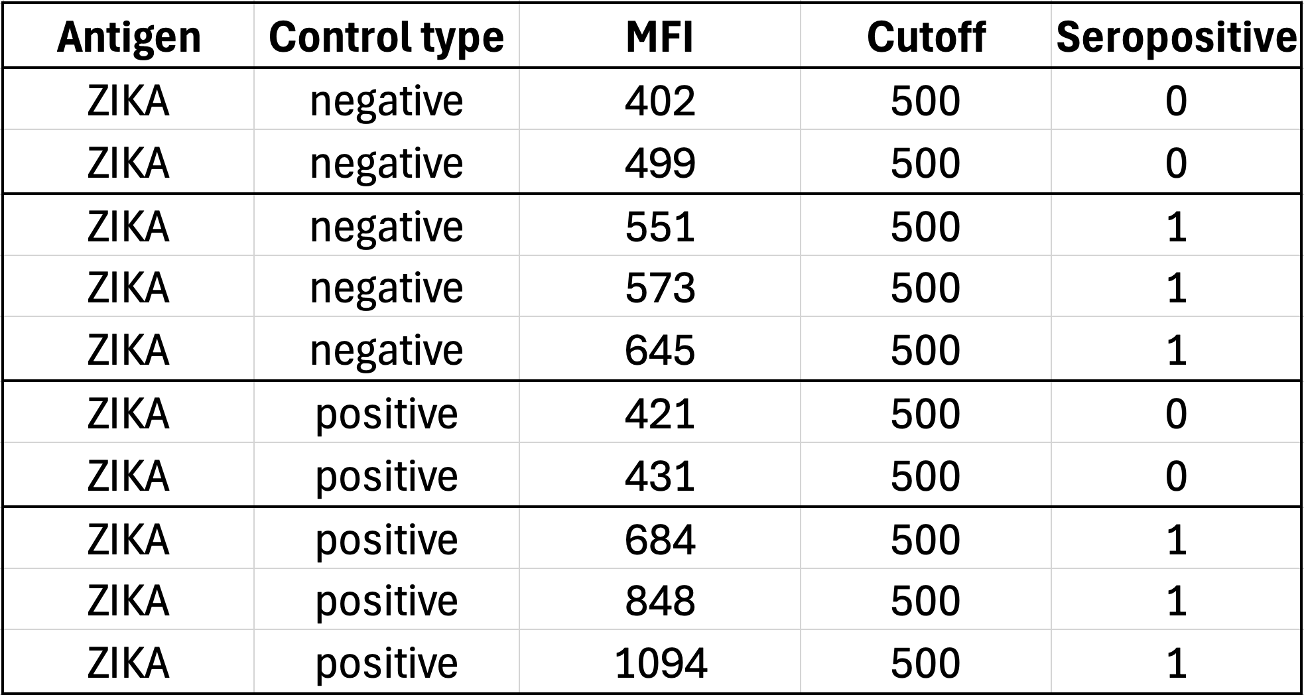
Applying cutoffs to ZIKA antigen controls
Serostatus
Based on cutoff
True negatives
False positives
False negatives
True positives
Notes:
Using a cutoff value of 500 , we can calculate the sensitivity and specificity:
R code:
# Define cutoff value
cutoff_value <- 500
# Create Seropos variable based on MFI cutoff
dat$Seropos <- ifelse(dat$MFI > cutoff_value, 1, 0)
# Calculate values for sensitivity and specificity
TP <- sum(dat$Seropos == 1 & dat$Pos_control == 1) # True Positives
TN <- sum(dat$Seropos == 0 & dat$Pos_control == 0) # True Negatives
FP <- sum(dat$Seropos == 1 & dat$Pos_control == 0) # False Positives
FN <- sum(dat$Seropos == 0 & dat$Pos_control == 1) # False Negatives
# Calculate Sensitivity and Specificity
Sensitivity <- TP / (TP + FN)
Specificity <- TN / (TN + FP)
# Print results
cat("True Positives:", TP, "\n")
cat("True Negatives:", TN, "\n")
cat("False Positives:", FP, "\n")
cat("False Negatives:", FN, "\n")
cat("Sensitivity:", round(Sensitivity, 3), "\n")
cat("Specificity:", round(Specificity, 3), "\n")
Write R code in one chunk. I have a df called dat, with variable Pos_control with 1 for positive controls and 0 for negative controls. I also have variable called MFI with a range of MFI values. Include cutoff_value <- 500. Create a variable called Seropos that is 1 if MFI > cutoff_value and 0 otherwise.
Then calculate the number of true positive, true negative, false positive, and false negative from this df. Then calculate Sensitivity and Specificity

Slide 10
2X2 table for ZIKA
A 2x2 table is a way to summarize TPs, FPs, TNs, and TPs
 |  | True disease status
 |  | Positive | Negative
Serostatus based on cutoff | Seropositive | 28 | 4
 | Seronegative | 2 | 26
True positives
False positives
True negatives
False negatives

Slide 11
False positives and false negatives: which are “worse”?
When would we want to minimize false positives?
When would we want to minimize false negatives?

Slide 12
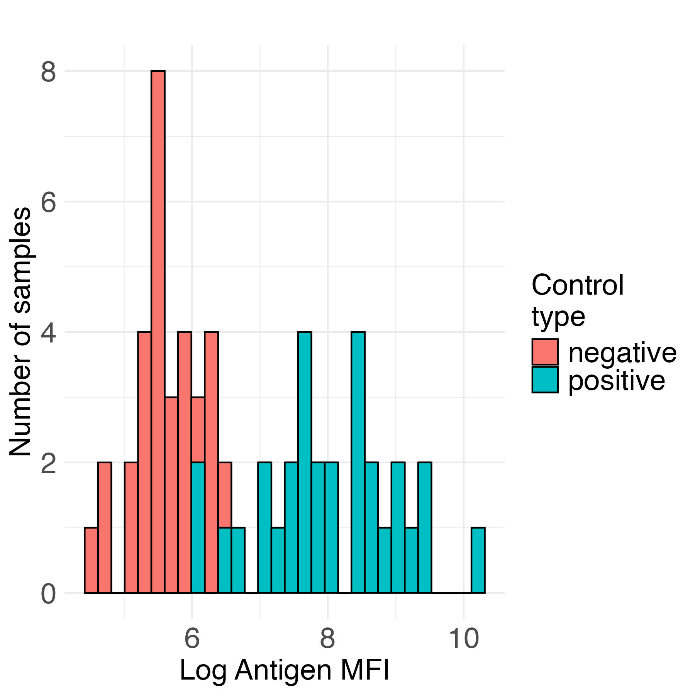
One way to think about this…
minimize false negatives
(maximize sensitivity)
minimize false positives (maximize specificity)
sero- negative
sero-
positive
Antigen MFI

Slide 13
False positives and false negatives: which are “worse”?
When would we want to minimize false positives?
Do not want to over-estimate exposure or immunity
Minimize unnecessary interventions
When would we want to minimize false negatives?
Do not want to miss any cases (risk of further transmission)
E.g., diseases near elimination or in early outbreak
Under-estimate disease burden

Slide 14
False positives and false negatives
In other cases, false positives and false negatives may be equally non desirable.
Then, we can choose to minimize the total number of false positives and false negatives (balanced approach).

Slide 15
Sensitivity and specificity
Sensitivity and specificity are measures of test accuracy that estimate how well true positives and true negatives are being captured.
In serosurveillance, sensitivity and specificity measure how well a cutoff accurately classifies people in the population as seronegative or seropositive.

Slide 16
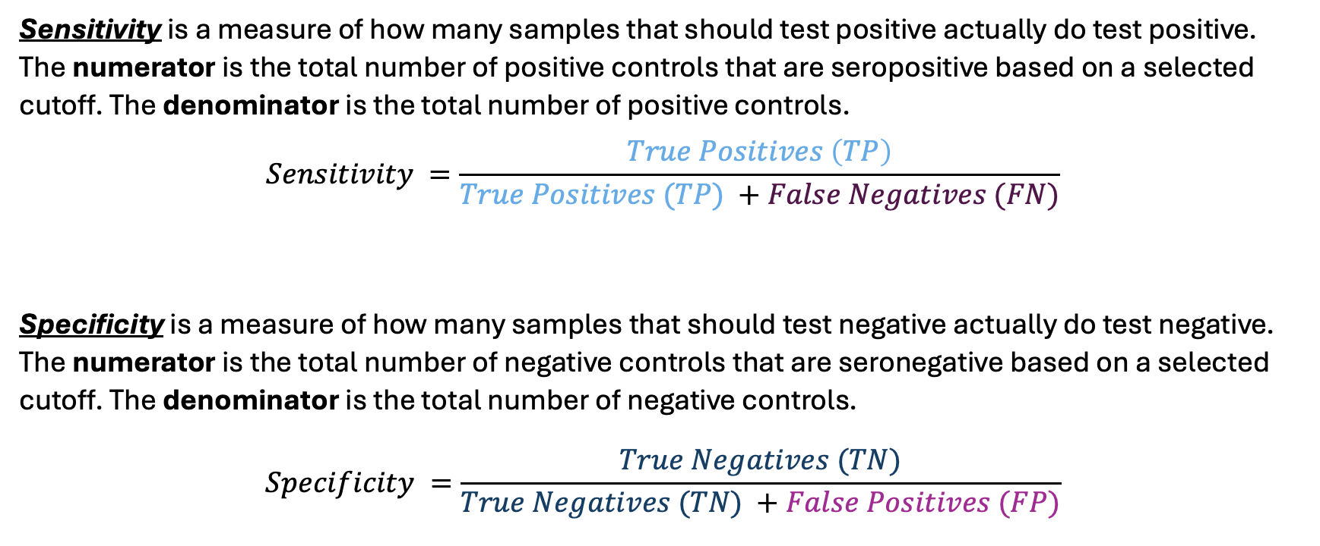
Sensitivity and specificity
Sensitivity is a measure of how many samples that should test positive actually do test positive. The numerator is the total number of positive controls that are seropositive based on a selected cutoff. The denominator is the total number of positive controls.
$$Sensitivity =\frac{True Positives \left(TP\right)}{True Positives (TP) +False Negatives (FN)}$$
Specificity is a measure of how many samples that should test negative actually do test negative. The numerator is the total number of negative controls that are seronegative based on a selected cutoff. The denominator is the total number of negative controls.
$$Specificity =\frac{True Negatives (TN)}{True Negatives (TN) +False Positives (FP)}$$

Slide 17
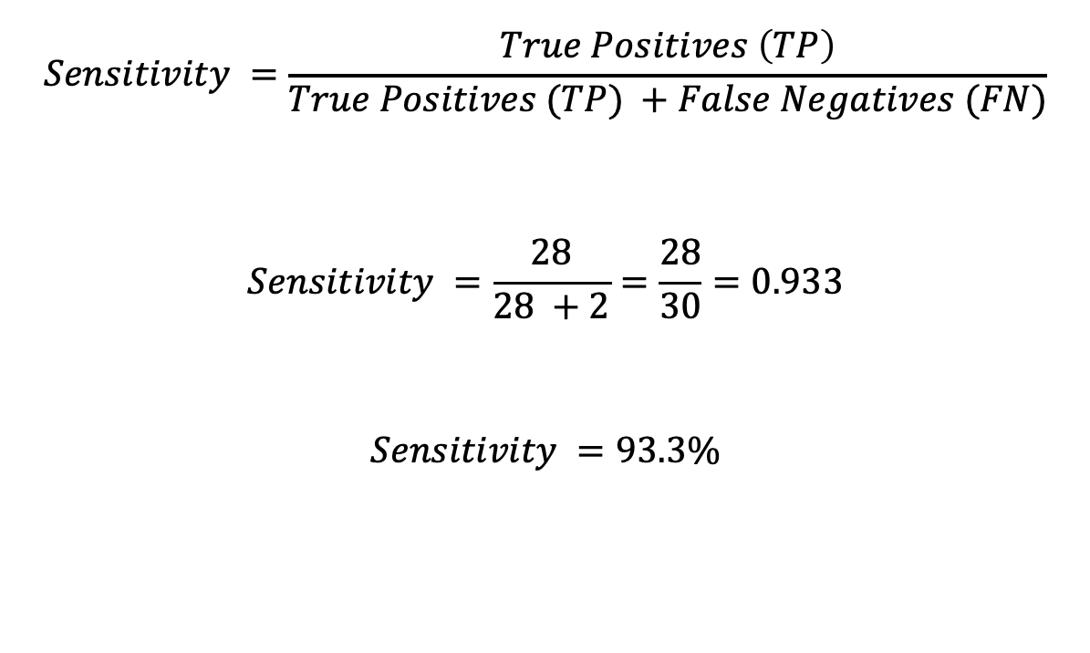
Sensitivity of ZIKA, cutoff = 500
For ZIKA antigen, using a cutoff of 500, we have:
26 true negatives
2 false negatives
28 true positives
4 false positives
$$Sensitivity =\frac{True Positives \left(TP\right)}{True Positives (TP) +False Negatives (FN)}$$
$$Sensitivity =\frac{28}{28 +2}=\frac{28}{30}=0.933$$
$$Sensitivity =93.3\%$$

Slide 18
Sensitivity of ZIKA, cutoff = 500
 |  | True disease status
 |  | Positive | Negative
Serostatus based on cutoff | Seropositive | 28 | 4
 | Seronegative | 2 | 26
True positives
False negatives

Slide 19
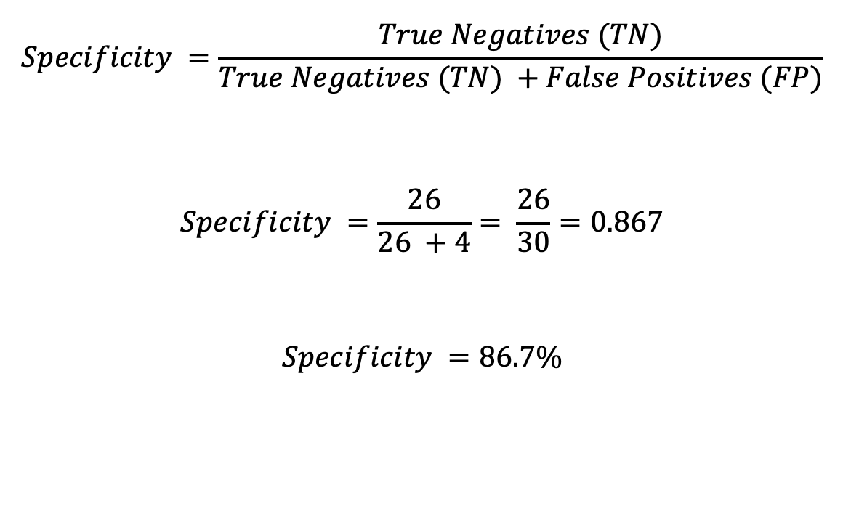
Specificity of ZIKA, cutoff = 500
For ZIKA antigen, using a cutoff of 500, we have:
26 true negatives
2 false negatives
28 true positives
4 false positives
$$Specificity =\frac{True Negatives (TN)}{True Negatives (TN) +False Positives (FP)}$$
$$Specificity =\frac{26}{26 +4}= \frac{26}{30}=0.867$$
$$Specificity =86.7\%$$

Slide 20
Specificity of ZIKA, cutoff = 500
 |  | True disease status
 |  | Positive | Negative
Serostatus based on cutoff | Seropositive | 28 | 4
 | Seronegative | 2 | 26
False positives
True negatives

Slide 21
Receiver Operating Characteristic (ROC) Curve
If we have positive and negative controls, we can compare sensitivity and specificity to help determine a cutoff.
The ROC curve uses known positive and negative controls to compare sensitivity vs. specificity.
We can use the ROC curve to choose a cutoff value that minimizes false positives and false negatives.

Slide 22
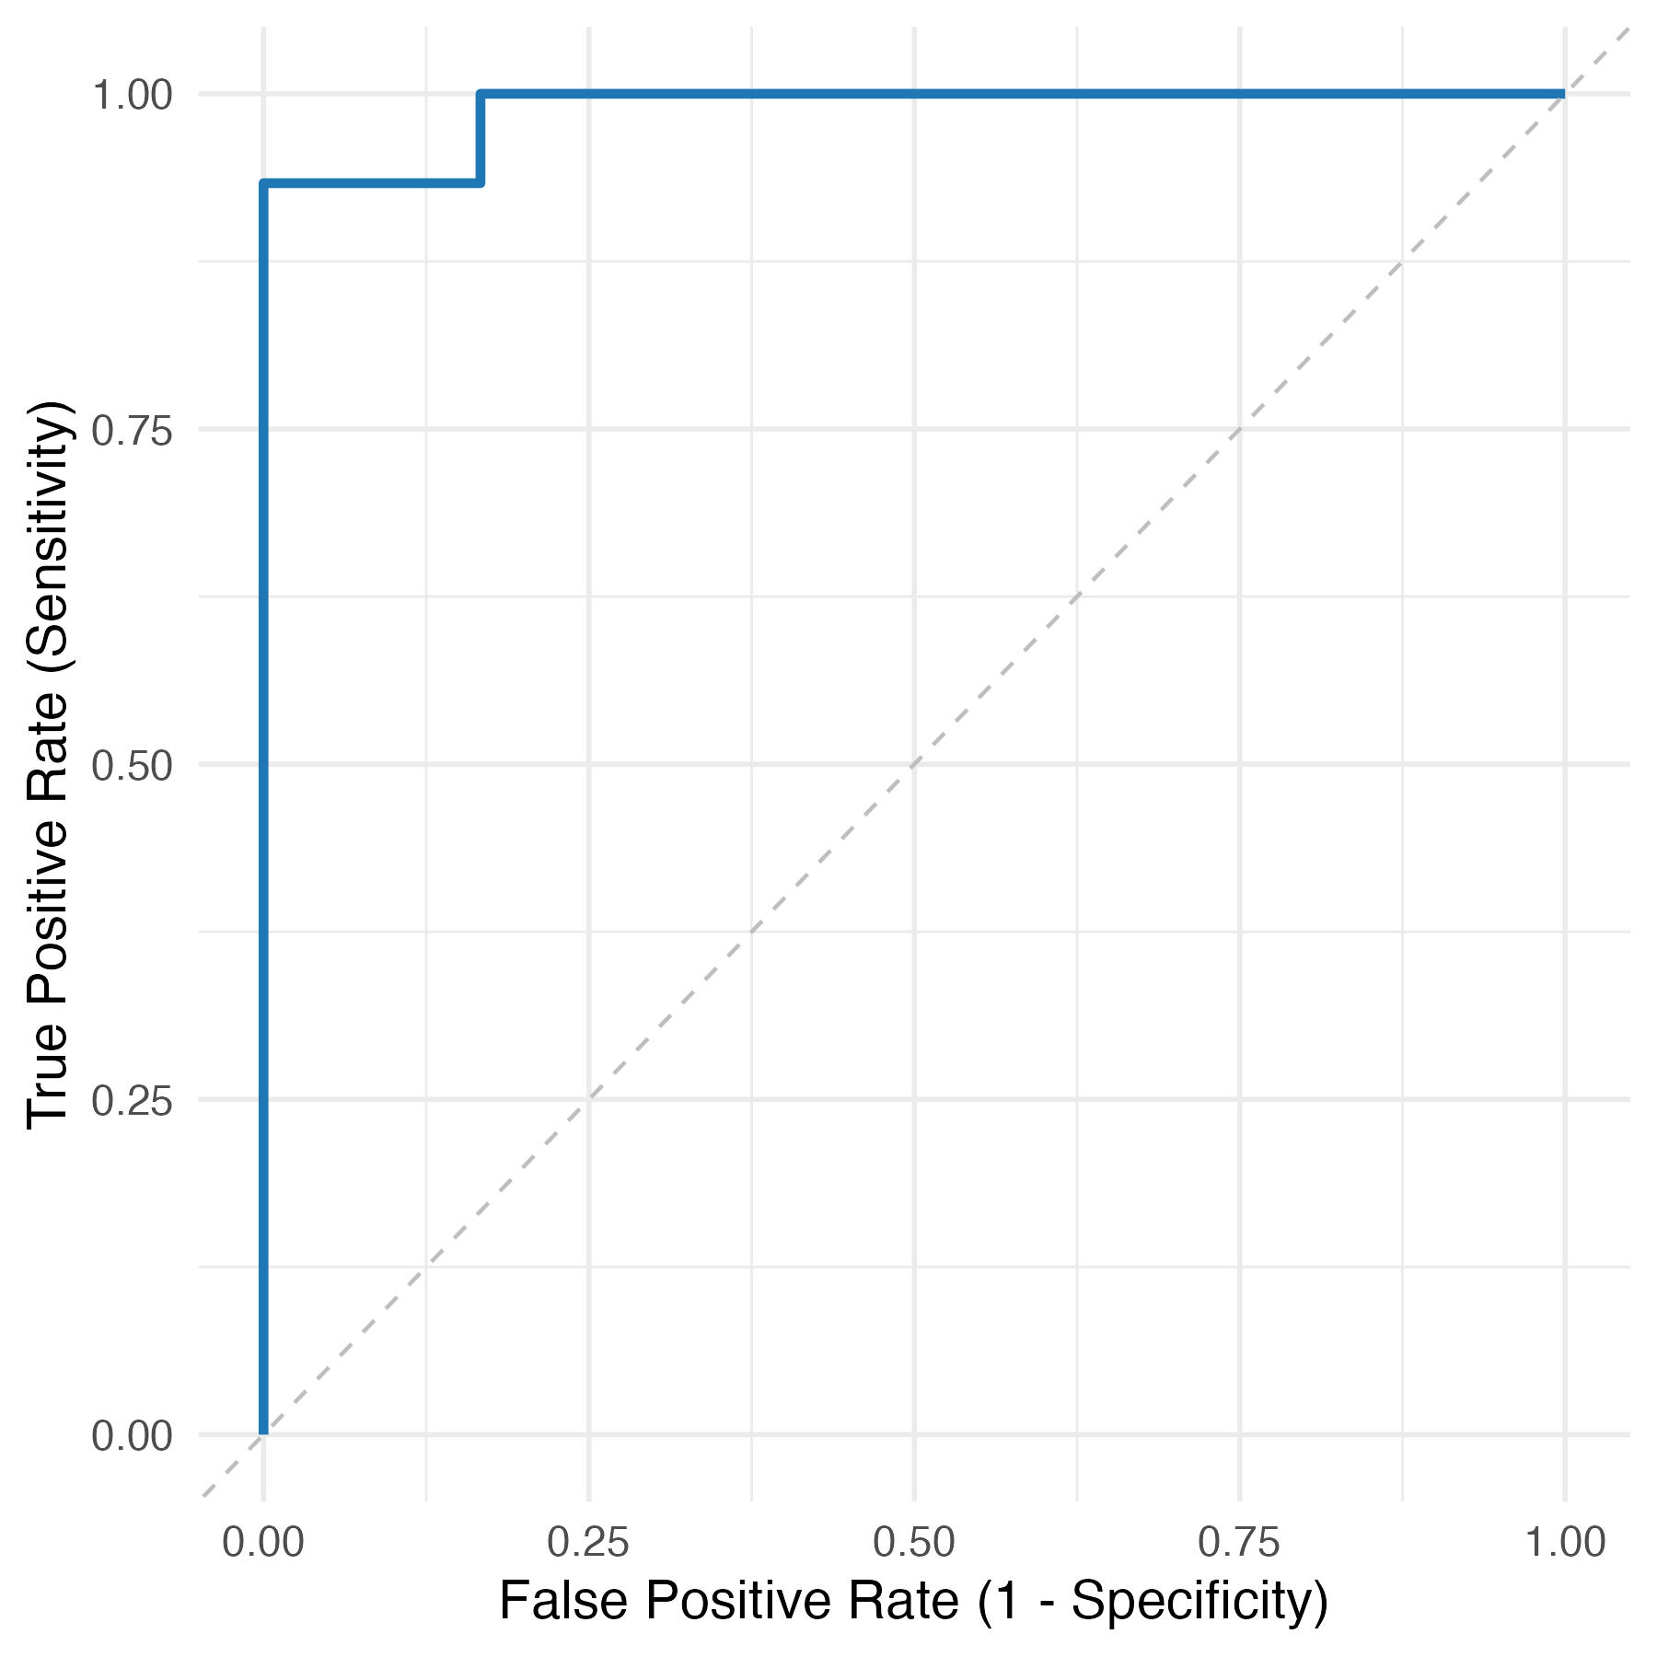
ROC Curves
The ROC curve shows sensitivity (true positive rate) and 1 – specificity (false positive rate) calculated at many different cutoff values.

Slide 23
ROC Curves
If the curve is close to the top left corner, then we can identify a cutoff with high sensitivity and specificity
Y-axis is sensitivity, equal to true positive rate
X-axis is 1-Specificity, equal to false positive rate

Slide 24
Choosing a cutoff from ROC Curve
The ROC curve shows us how sensitivity and specificity change as we adjust the cutoff value. It does not give a specific cutoff value.
How to chose what cutoff to chose:
Consider: Is it worse to have false negatives or false positives?
Is it worse to have false positives (labeling negative people as positive)? For example, for a rare disease?
Is it worse to have false negatives (missing seropositive people)?
Or are false positives and false negatives equally bad?

Slide 25
Cutoffs from ROC curve – Youden’s Index
One common method to choose a cutoff from a ROC curve is to use Youden’s Index
This method assumes false positive and false negatives are equally bad
This method finds the cutoff that maximizes Sensitivity + Specificity – 1

Slide 26
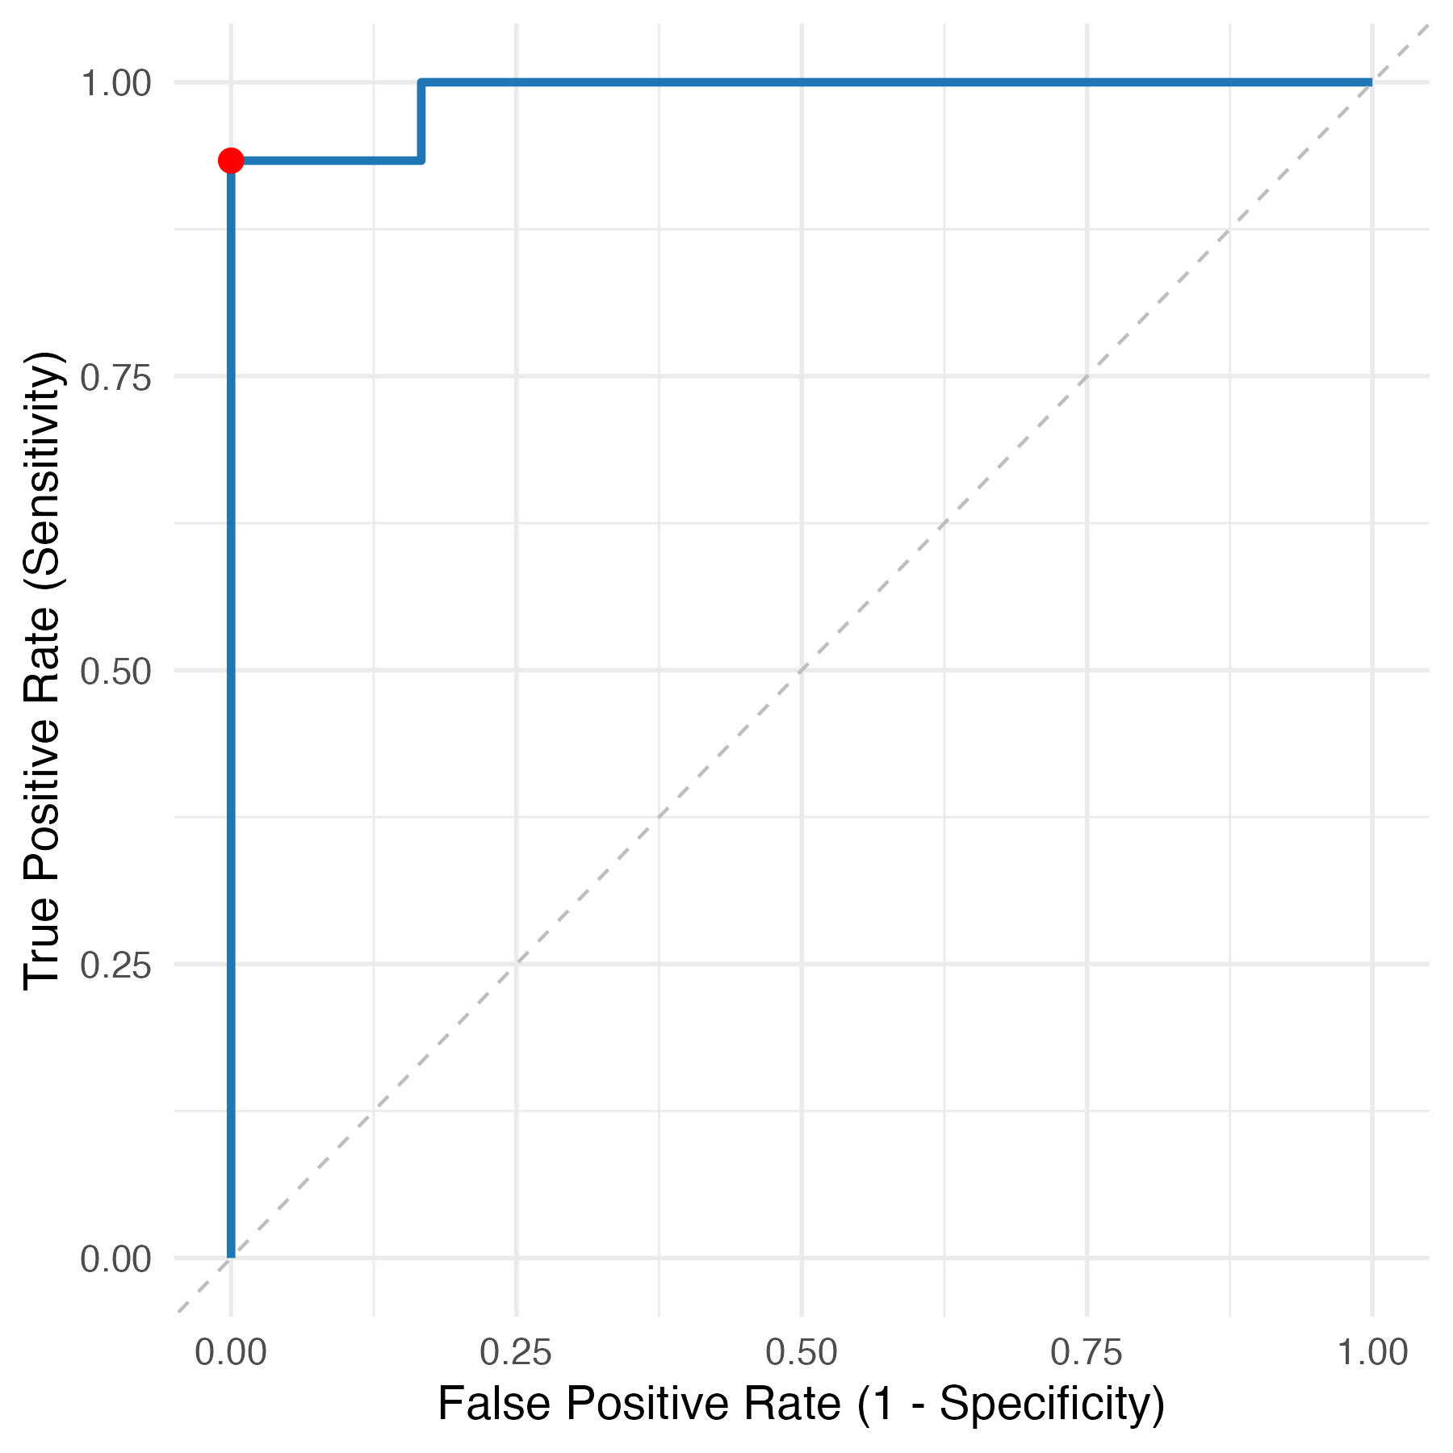
Cutoffs from ROC curve – Youden’s Index
When we maximize Sensitivity + Specificity – 1 for this ROC curve:
Cutoff based on Youden’s index: TPR: 0.933 FPR: 0
Cutoff: 664.5
Notes:
Pretty good sensitivity and specificity based on this cutoff
Youden’s Index = TPR – FPR 0.933 – 0 = 0.933 (max is 1)

Slide 27
Cutoffs from ROC curve
Can also adjust the cutoff if we primarily want to minimize false positives or false negatives, for example:
If we are concerned about too many false positives, we could set a minimum value for specificity (e.g., find cutoff that provides maximum sensitivity while maintaining >80% specificity)

Slide 28
ROC curve summary
Advantages:
Flexibility to prioritize sensitivity or specificity
Disadvantages:
Requires positive and negative controls
Controls may differ from sample population

Slide 29
Mean + Standard Deviation
This method uses negative controls: for example, from a non-endemic region or from young individuals who are presumed to be unexposed
Cutoff = mean + 2 or 3 standard deviations
If negative controls are normally distributed:
Only ~2.5% of negatives are expected to be above mean + 2SDs
Only ~0.14% of negatives are expected to be above mean + 3SDs
Notes:
Advantage: only requires negative controls, which may be easier to obtain than positive controls, especially for rare diseases

Slide 30
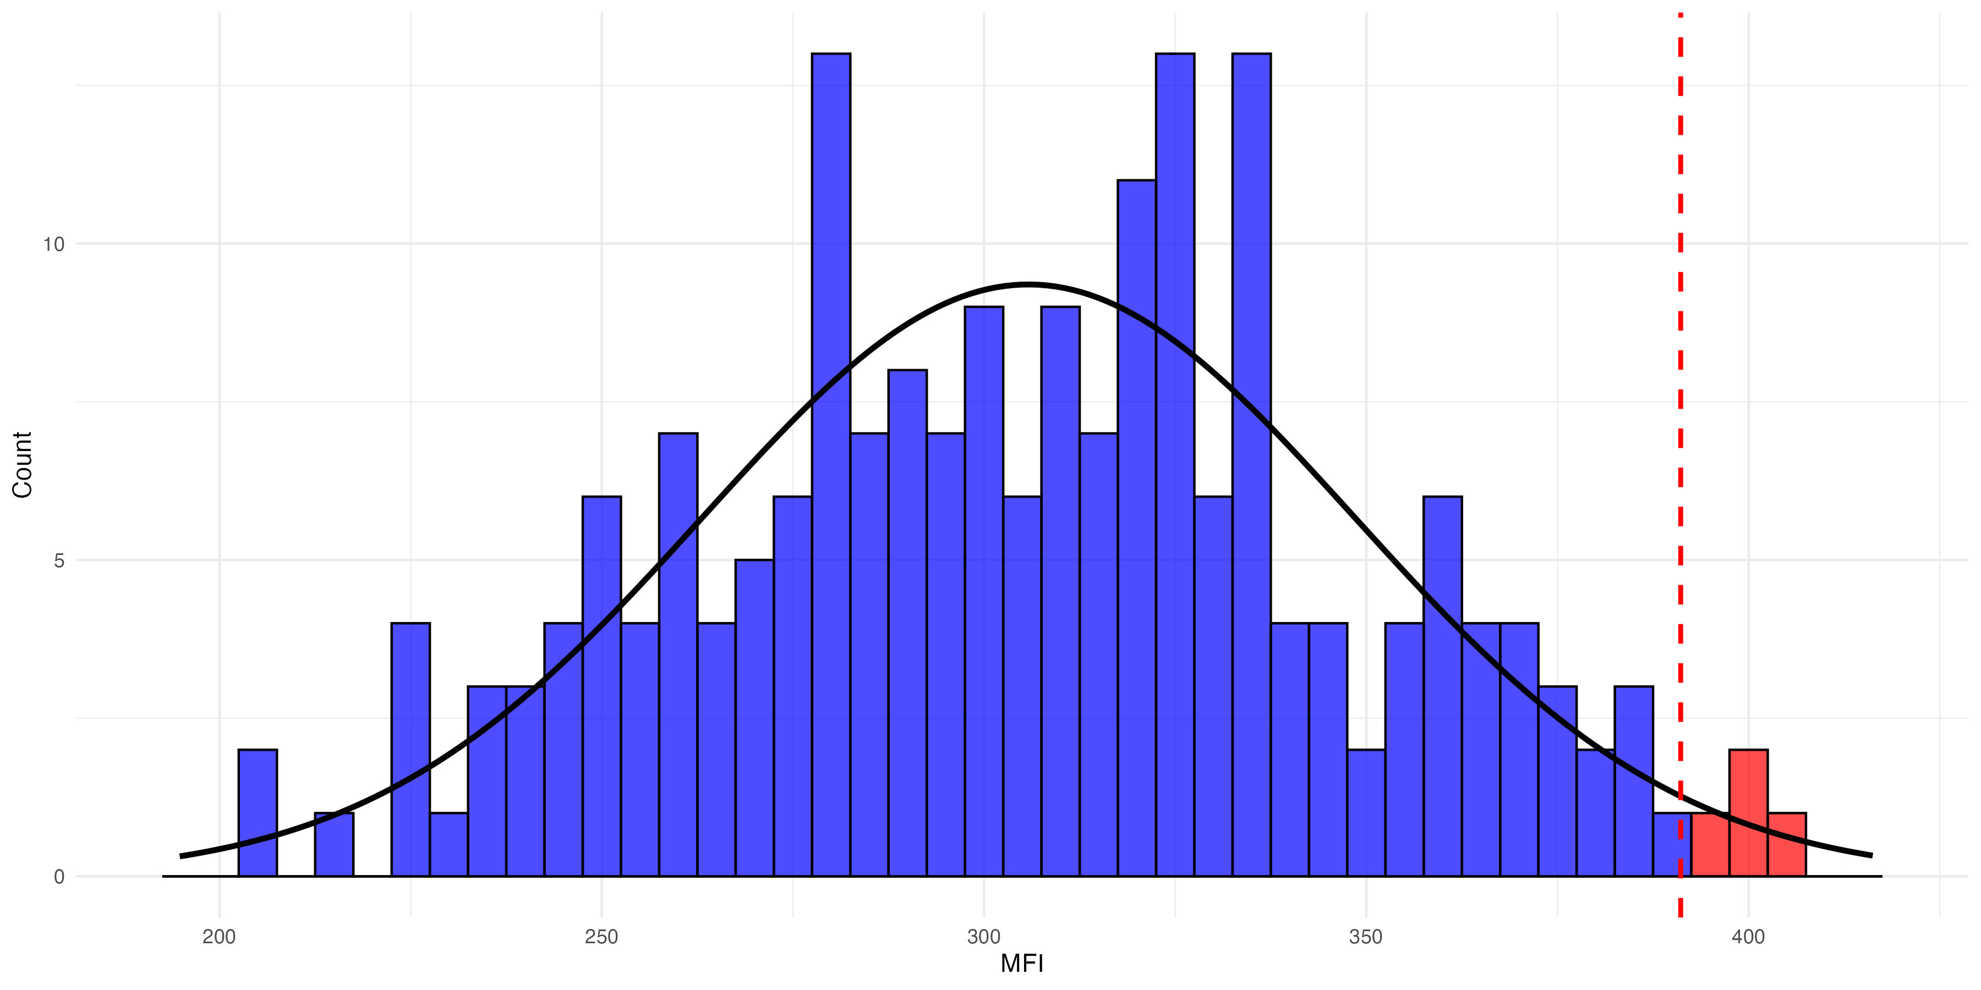
Unexposed controls
If controls are normally distributed: For mean + 2 SDs, we expect 2.5% of negative samples to be greater than cutoff (i.e., assay has 97.5% specificity).
Notes:
The data shows a simulated normal distribution. The curve models a normal distribution. Samples above the cutoff are shown in red and samples below the cutoff are shown in blue.

Slide 31
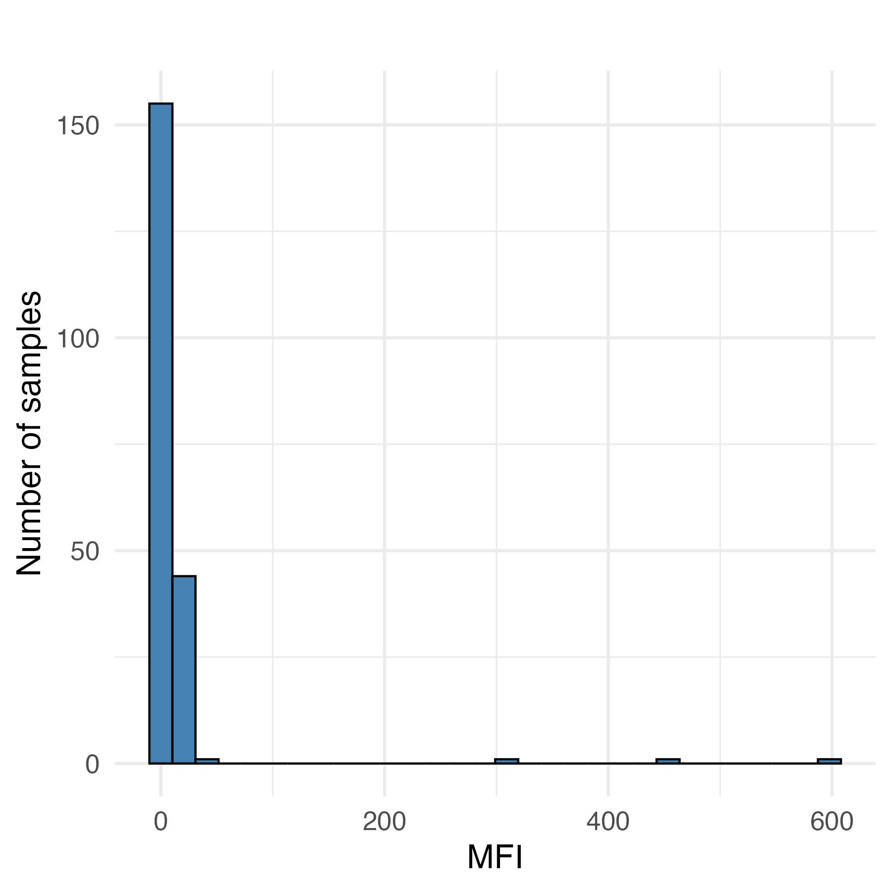
Unexposed controls
There can sometimes be outliers in unexposed controls (high-responders)
This could be a reason for a non-normal distribution
A more conservative approach is using highest negative control (equals 100% specificity)
It’s also worth investigating the outlier samples to try to understand if they were truly unexposed
Outliers
Notes:
Advantage: only requires negative controls, which may be easier to obtain than positive controls, especially for rare diseases

Slide 32
Unexposed controls
Advantages:
Simple to implement
Doesn’t require positive controls (often harder to find, depending on pathogen)
Disadvantages:
Negative controls should be comparable to true negative samples in population
Specificity may be challenging to estimate depending on the number and distribution of negative controls
Can’t estimate sensitivity or numbers of false negatives (if no positive controls)
Notes:
Advantages
Simple to implement
Disadvantages
Only works if controls are normally distributed, or could have larger numbers above cutoff by chance
Requires negative controls to be comparable to true negative samples in population
Could result in false negatives if there is overlap between true positives and normal distribution of negatives

Slide 33
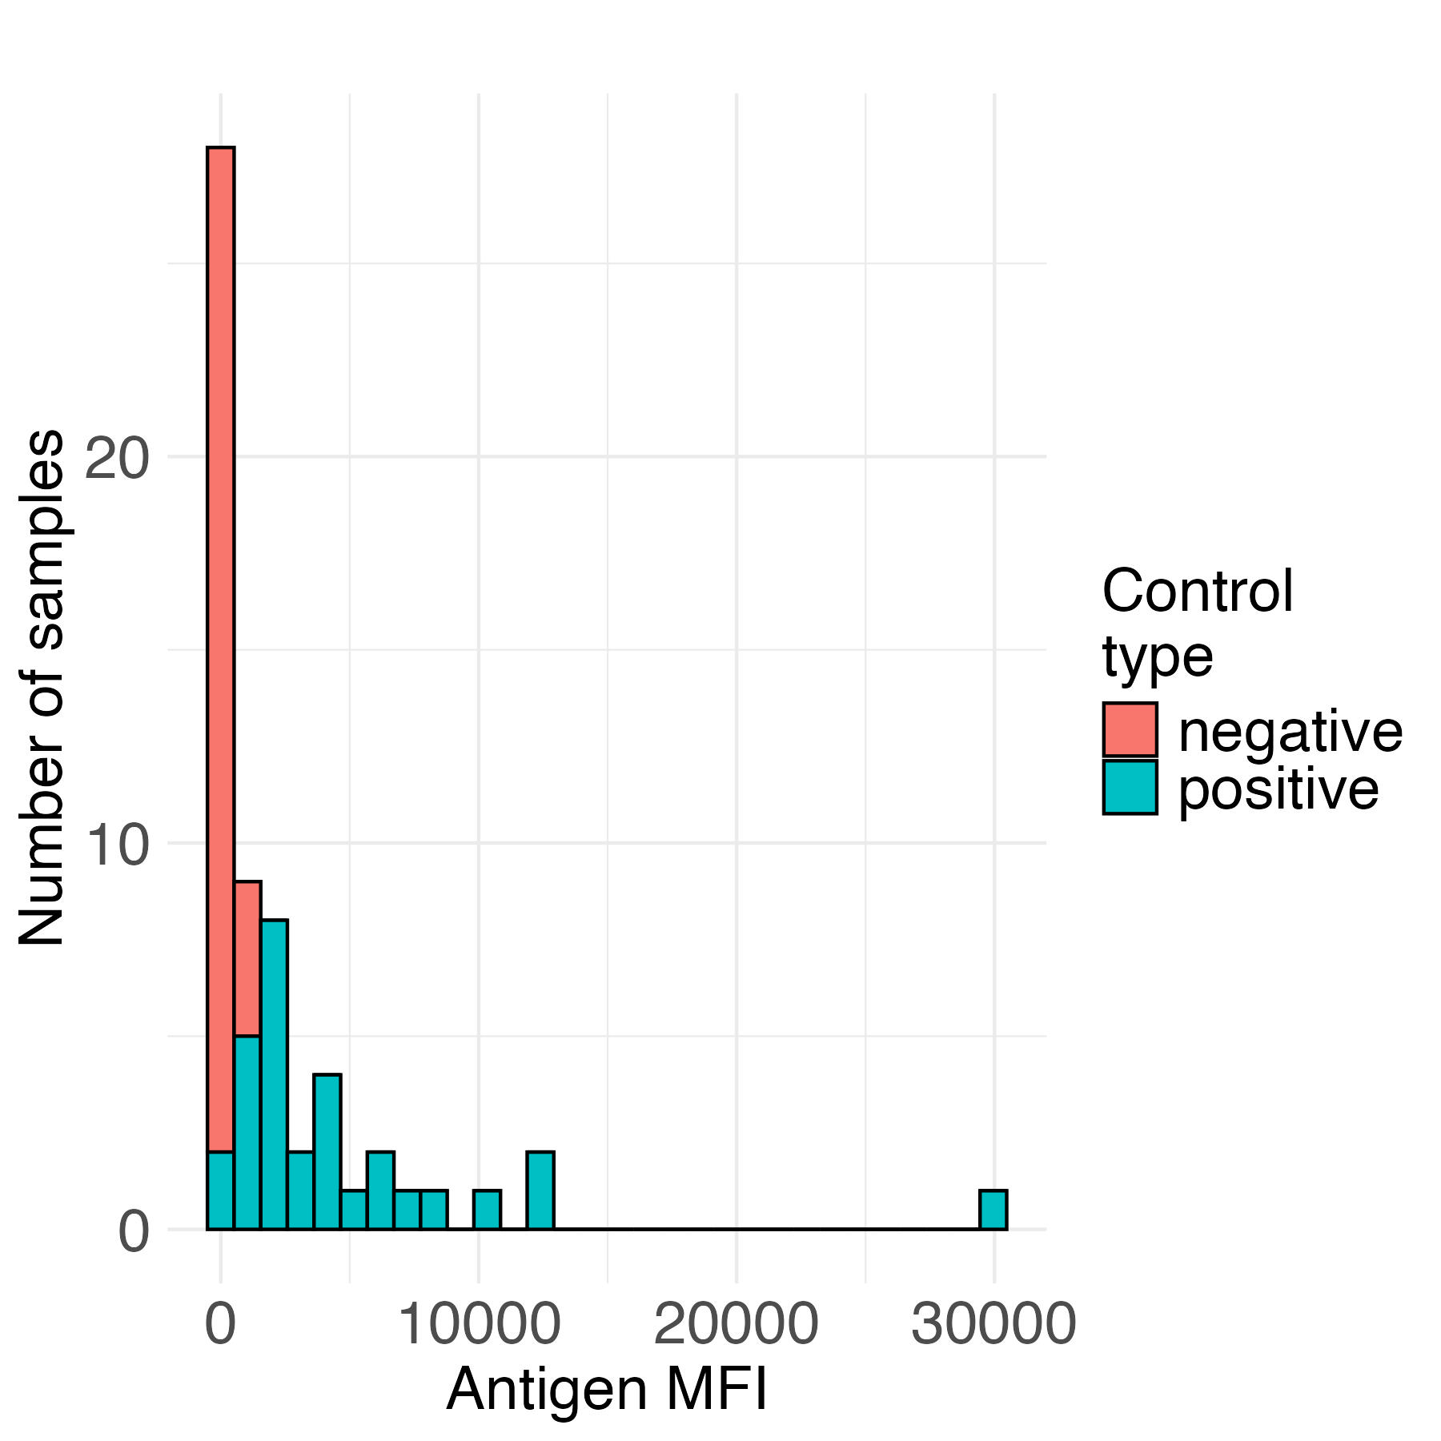
Distributions of controls
For ZIKA antigen: Overlap between distributions of true positives and negatives
Untransformed
Log scale
Notes:
Advantages
Simple to implement
Disadvantages
Only works if controls are normally distributed, or could have larger numbers above cutoff by chance
Requires negative controls to be comparable to true negative samples in population
Could result in false negatives if there is overlap between true positives and normal distribution of negatives

Slide 34
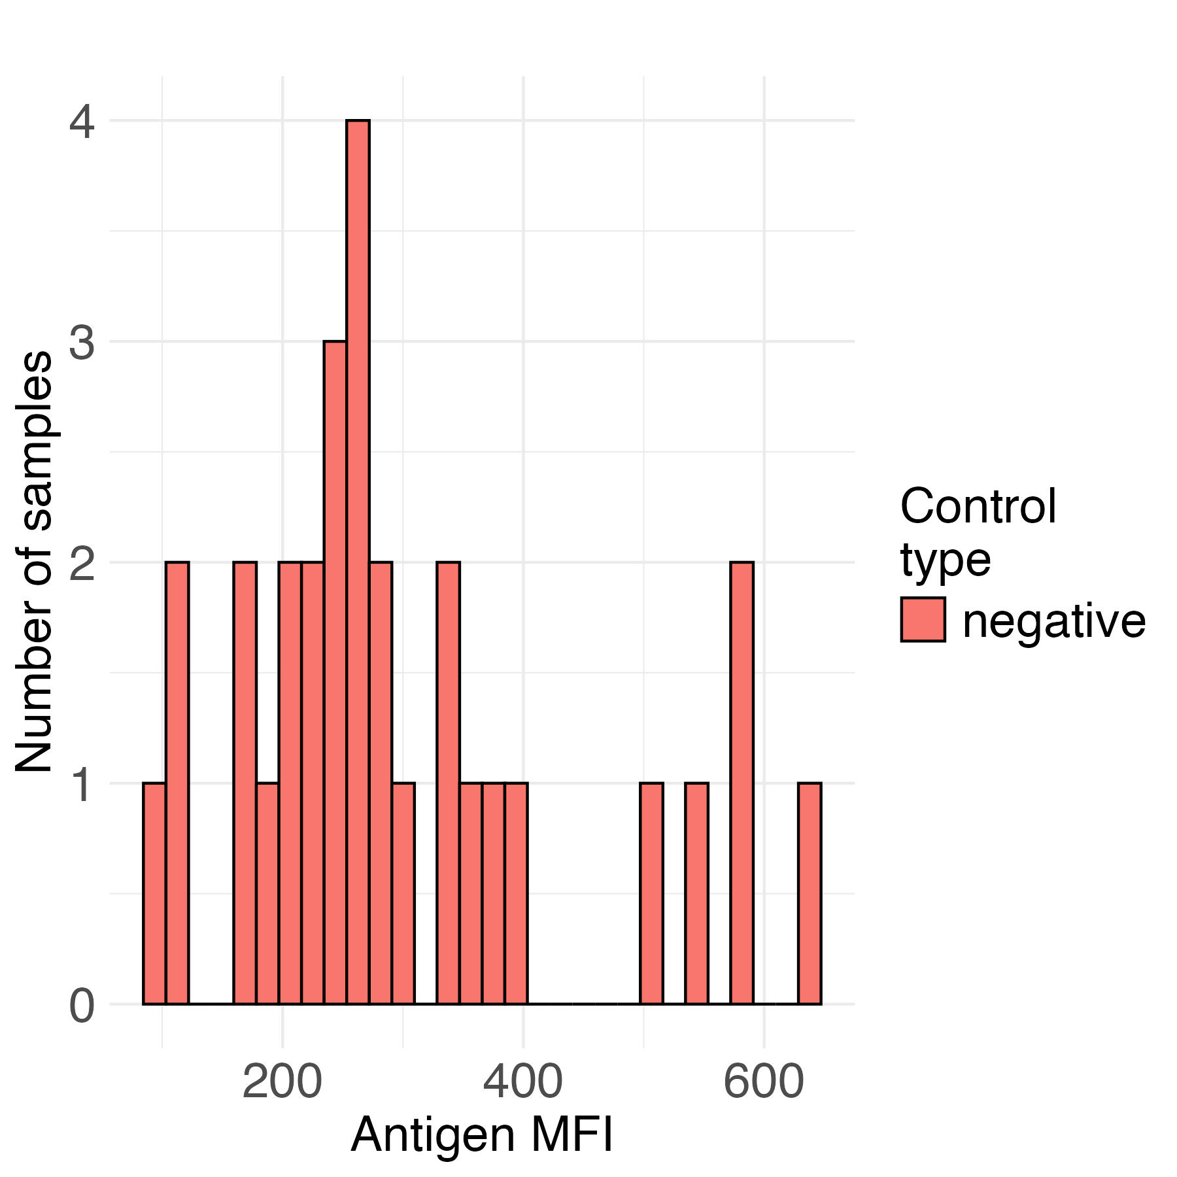
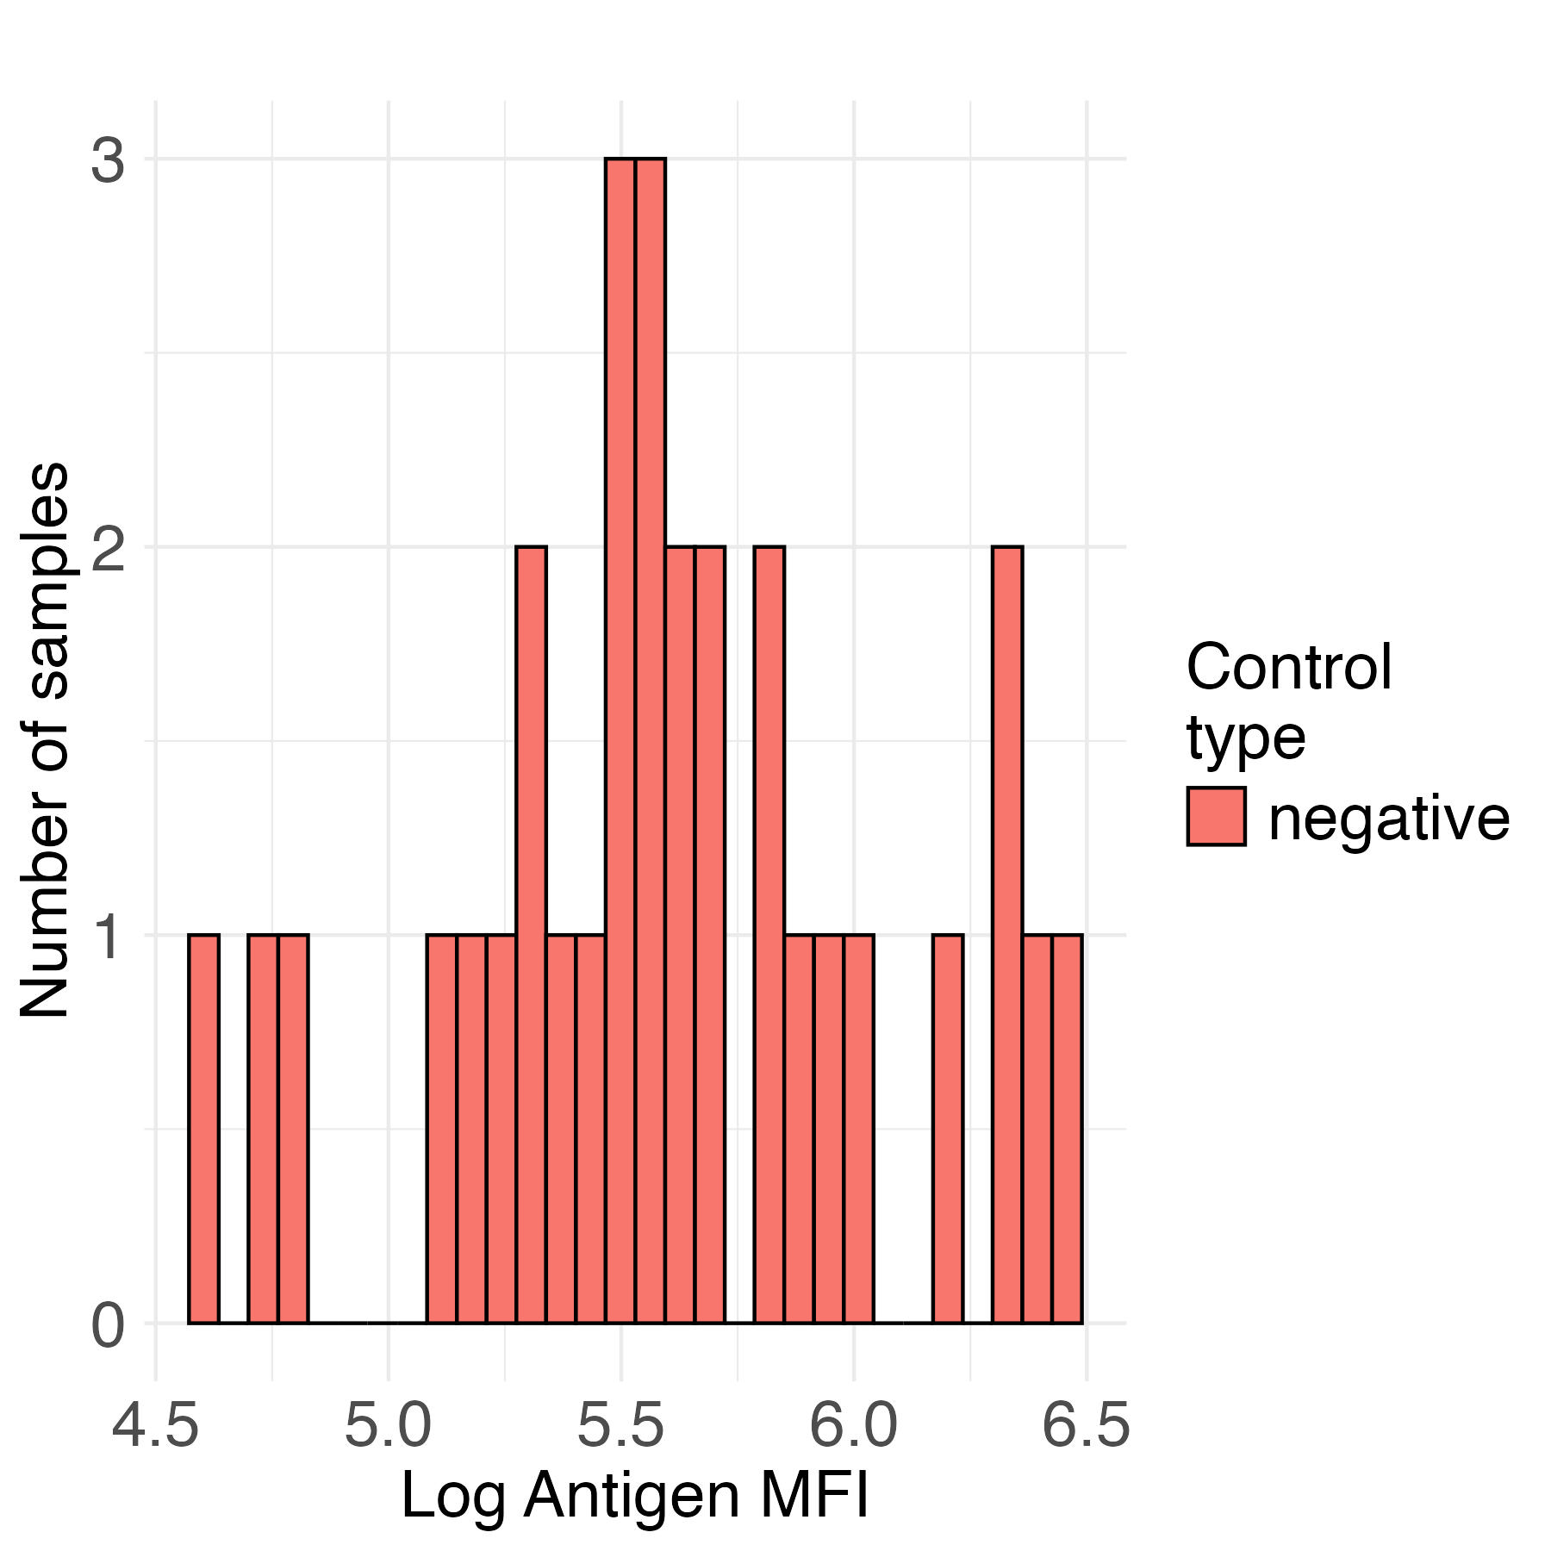
Distribution of negative controls
ZIKA antigen negative controls
Untransformed
Log scale
Notes:
Untransformed and log scale both look pretty good. There’s generally little downside to doing a log transformation
R code demo:
neg_controls <- dat$AntibodyLevel[dat$KnownStatus == "Negative"]
cutoff_3sd <- mean(neg_controls, na.rm = TRUE) + 3 * sd(neg_controls, na.rm = TRUE)
cutoff_5sd <- mean(neg_controls, na.rm = TRUE) + 5 * sd(neg_controls, na.rm = TRUE)
print(cutoff_3sd)
print(cutoff_5sd)

Slide 35
Cutoffs using ZIKA negative controls:
Mean log(ZIKA negative controls) = 5.600
SD log(ZIKA negative controls) = 0.473
Cutoff = mean + 2 SD of negative controls
Cutoff = exp(5.600 + 2 * 0.473) = exp(6.545) = 695.9
Cutoff = mean + 3 SD of negative controls
Cutoff = exp(5.600 + 3 * 0.473) = exp(7.018) = 1116.5

Slide 36
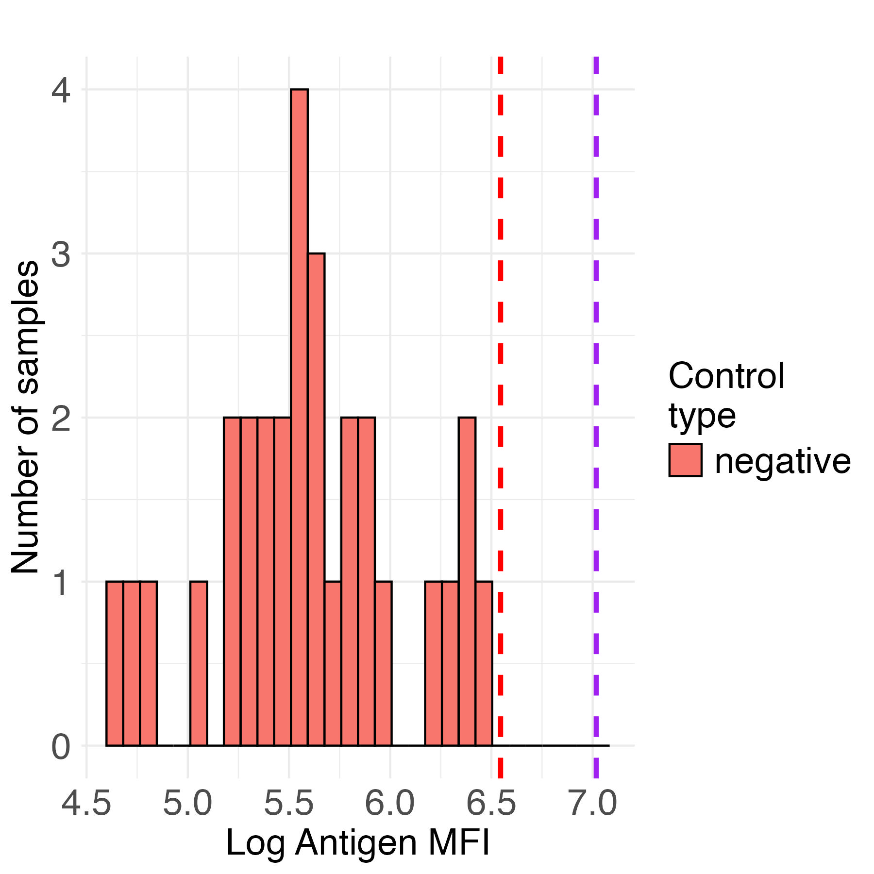
Cutoffs using ZIKA negative controls:
Histogram of negative controls with cutoffs:
In red: Mean + 2SD = 695.9
In purple: Mean + 3SD = 1116.5

Slide 37
Specificity of ZIKA antigen
For a cutoff = 695.9:
If no positive controls available:
 |  | True disease status
 |  | Positive | Negative
Serostatus based on cutoff | Seropositive | - | 0
 | Seronegative | - | 30

Slide 38
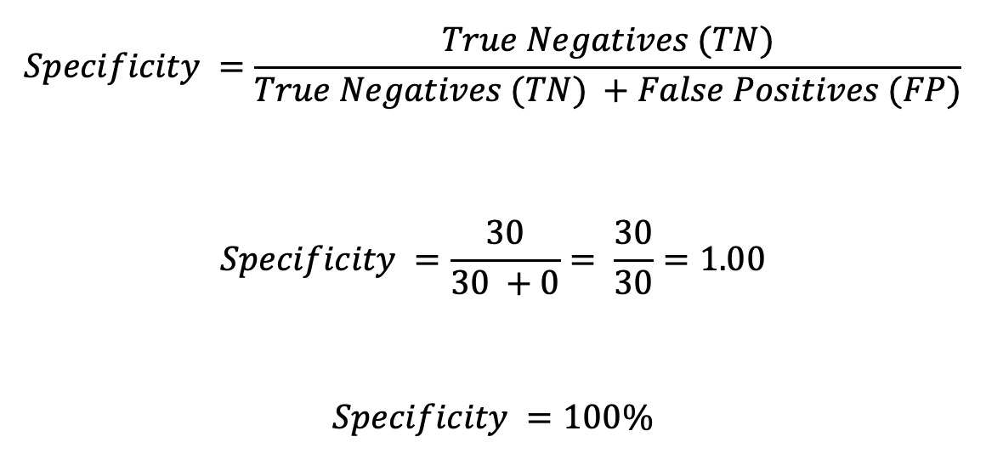
Specificity of ZIKA antigen
For a cutoff = 695.9:
$$Specificity =\frac{True Negatives (TN)}{True Negatives (TN) +False Positives (FP)}$$
$$Specificity =\frac{30}{30 +0}= \frac{30}{30}=1.00$$
$$Specificity =100\%$$

Slide 39
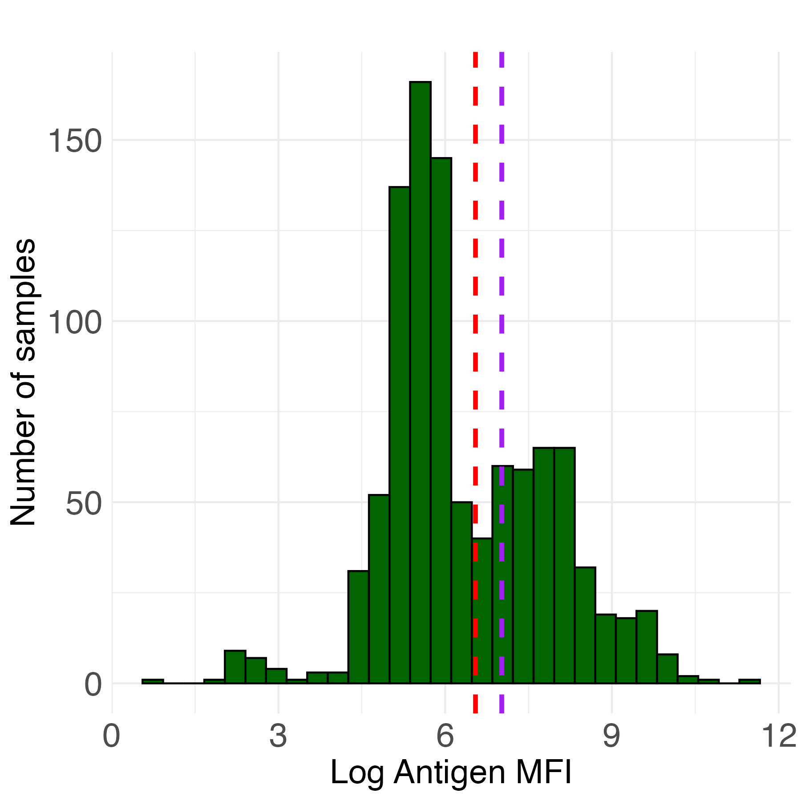
Cutoffs using ZIKA negative controls:
Histogram of samples
with cutoffs:
In red: Mean + 2SD = 695.9
In purple: Mean + 3SD = 1116.5

Slide 40
Mixture models
Mixture models are the only method to estimate (1) the probability that a sample is seropositive and (2) seroprevalence directly from the sample distribution
Does not require positive or negative controls

Slide 41
Mixture models
Advantage:
Doesn’t require positive or negative controls
Disadvantage:
Only works if we can identify distributions representing exposed and unexposed individuals (ideally with minimal overlap)

Slide 42
Mixture models
Why may we not see two distinct distributions for exposed and unexposed individuals in a population (e.g., either 1 or 3+ distributions)?
Almost all / almost no individuals exposed
Waning antibodies over time
Cross-reactive antibodies
Magnitude of antibody response could vary with intensity of infection
Natural infection vs. vaccination

Slide 43
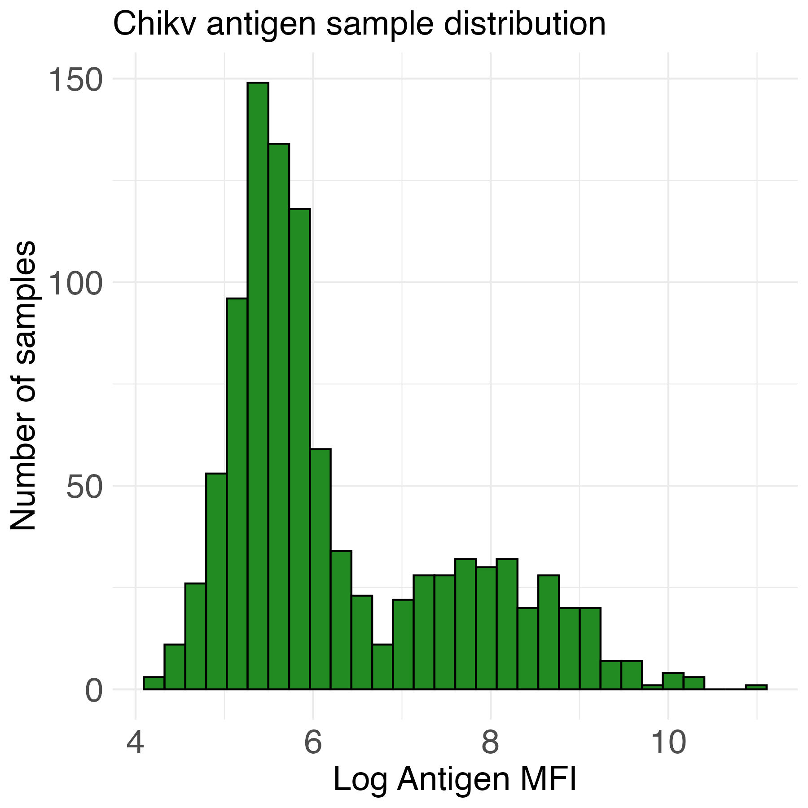
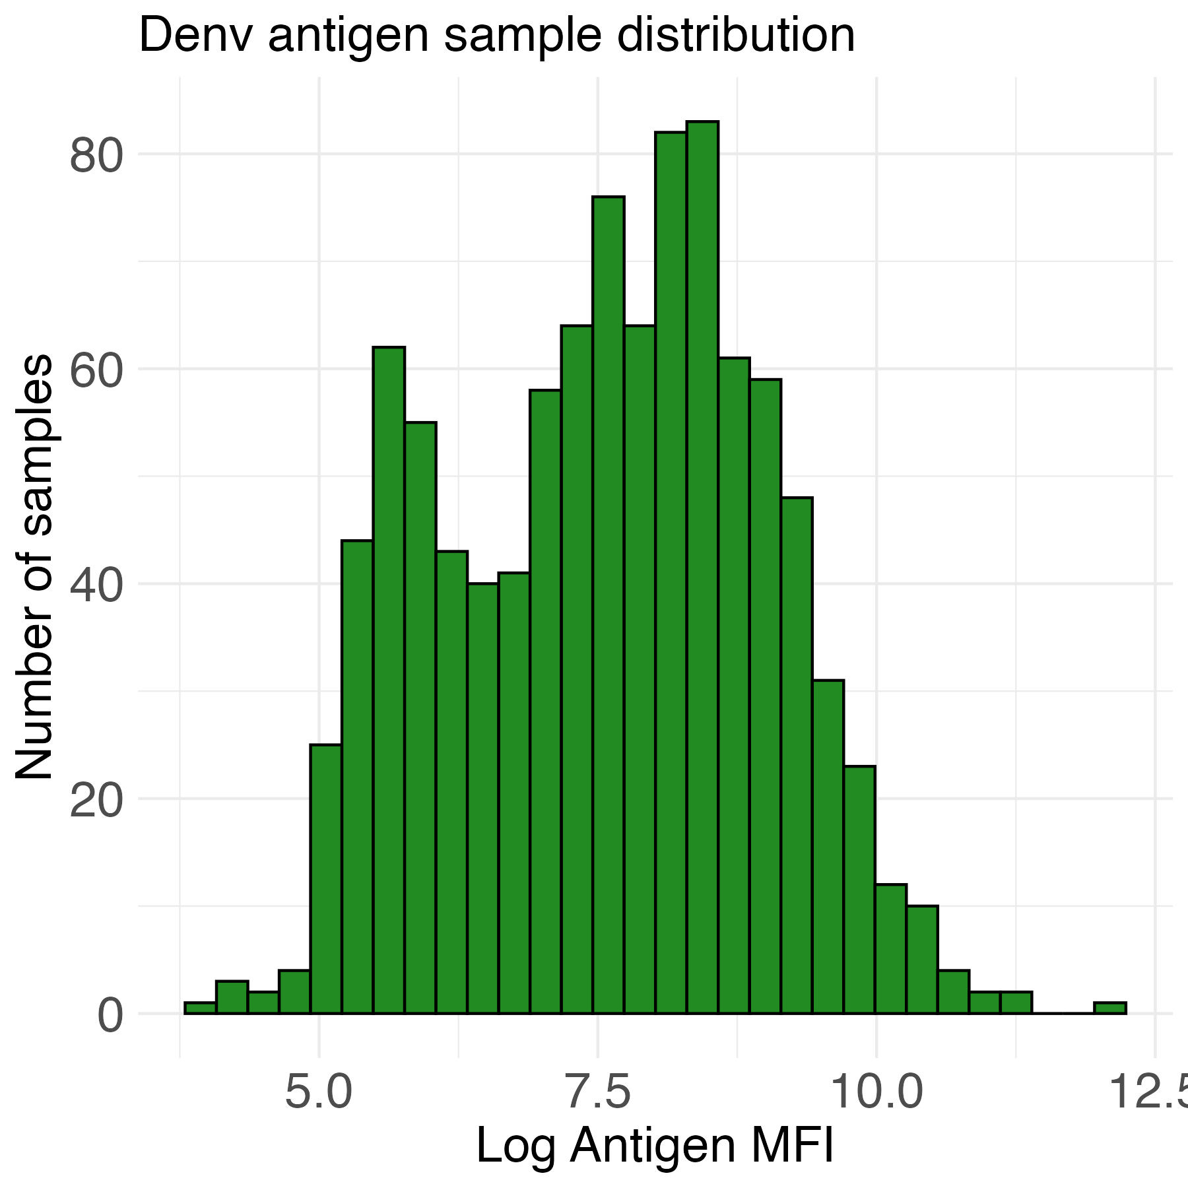
Mixture models
Chikv and Denv could be appropriate distributions for fitting a mixture model (possibly two components per antigen)
Notes:
Both have possible bimodal distributions

Slide 44
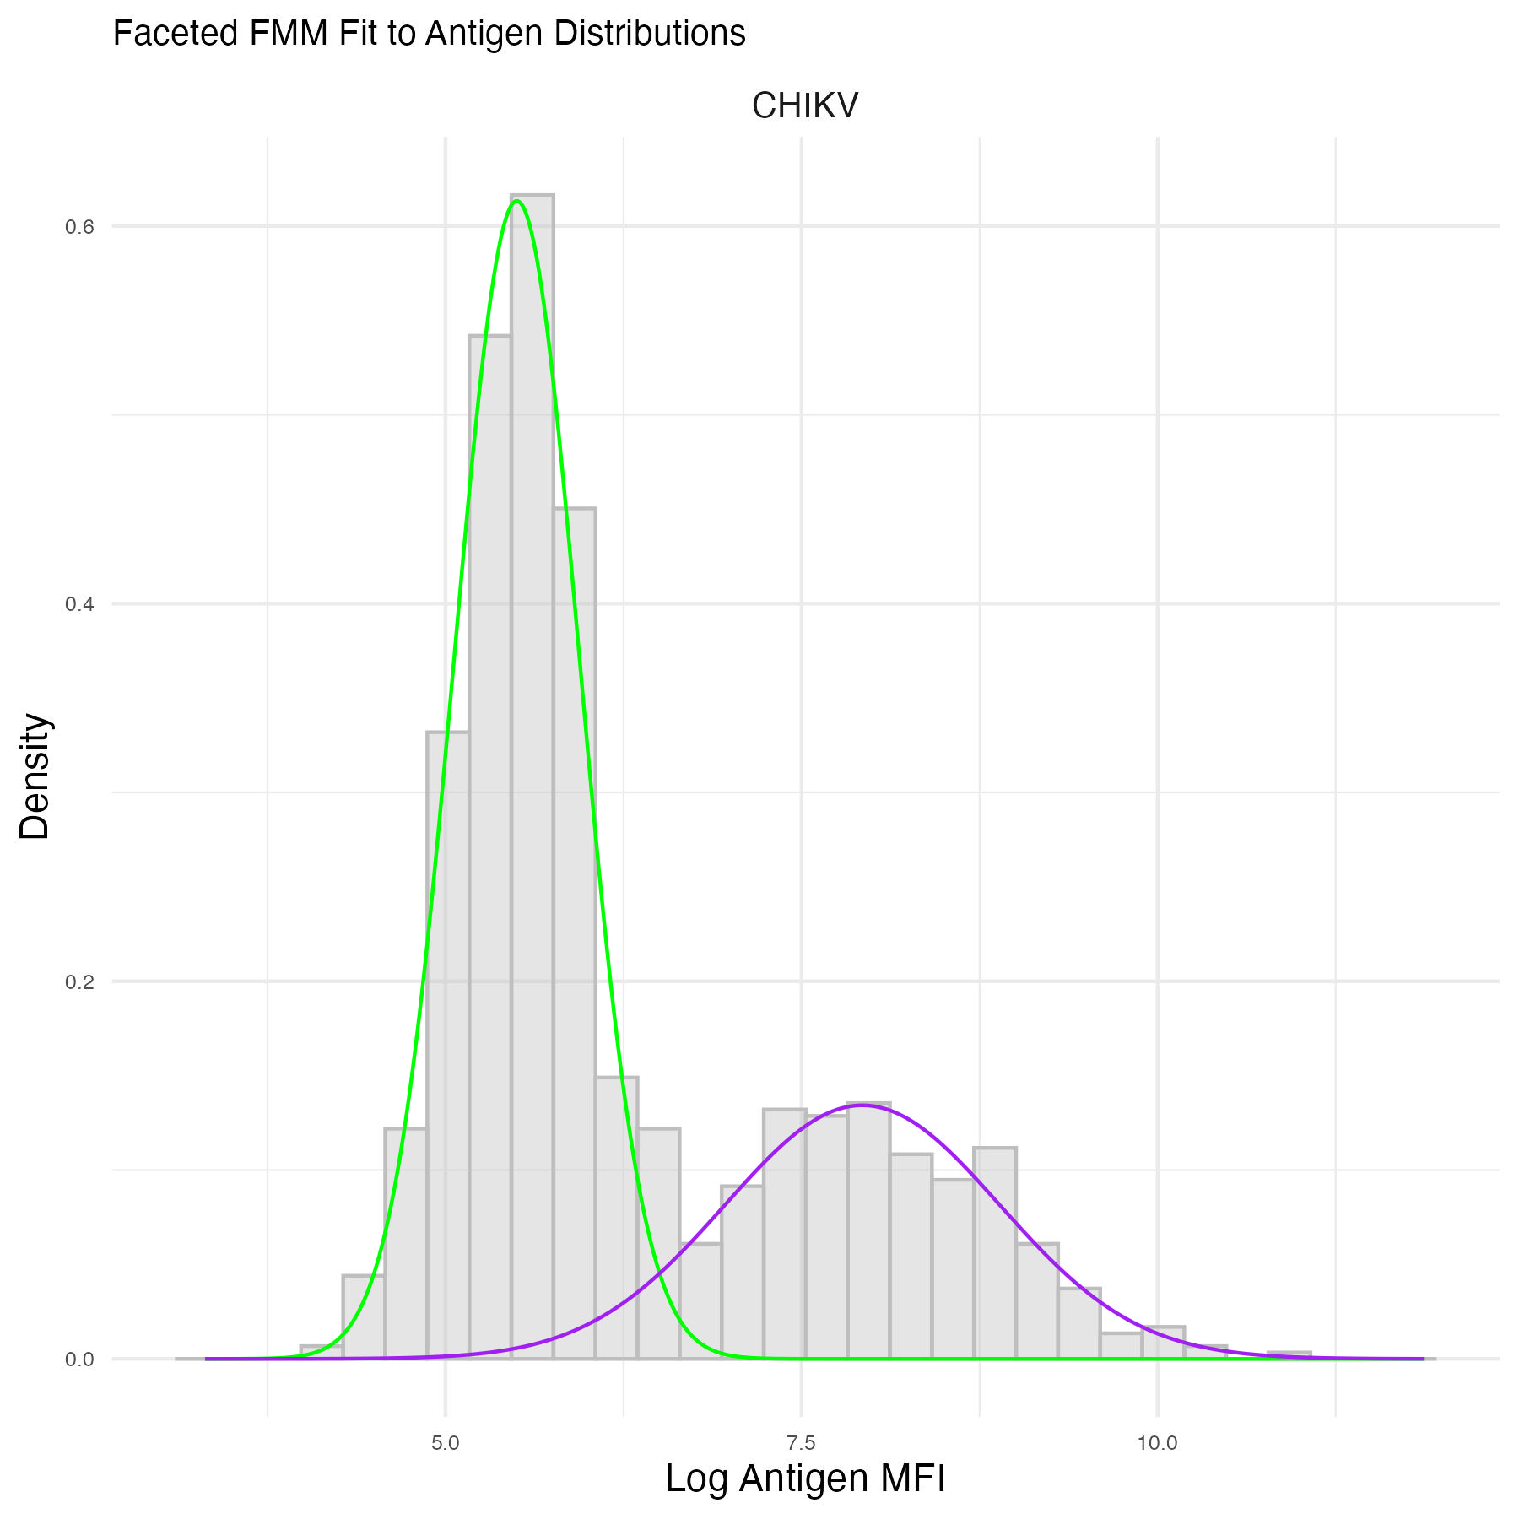
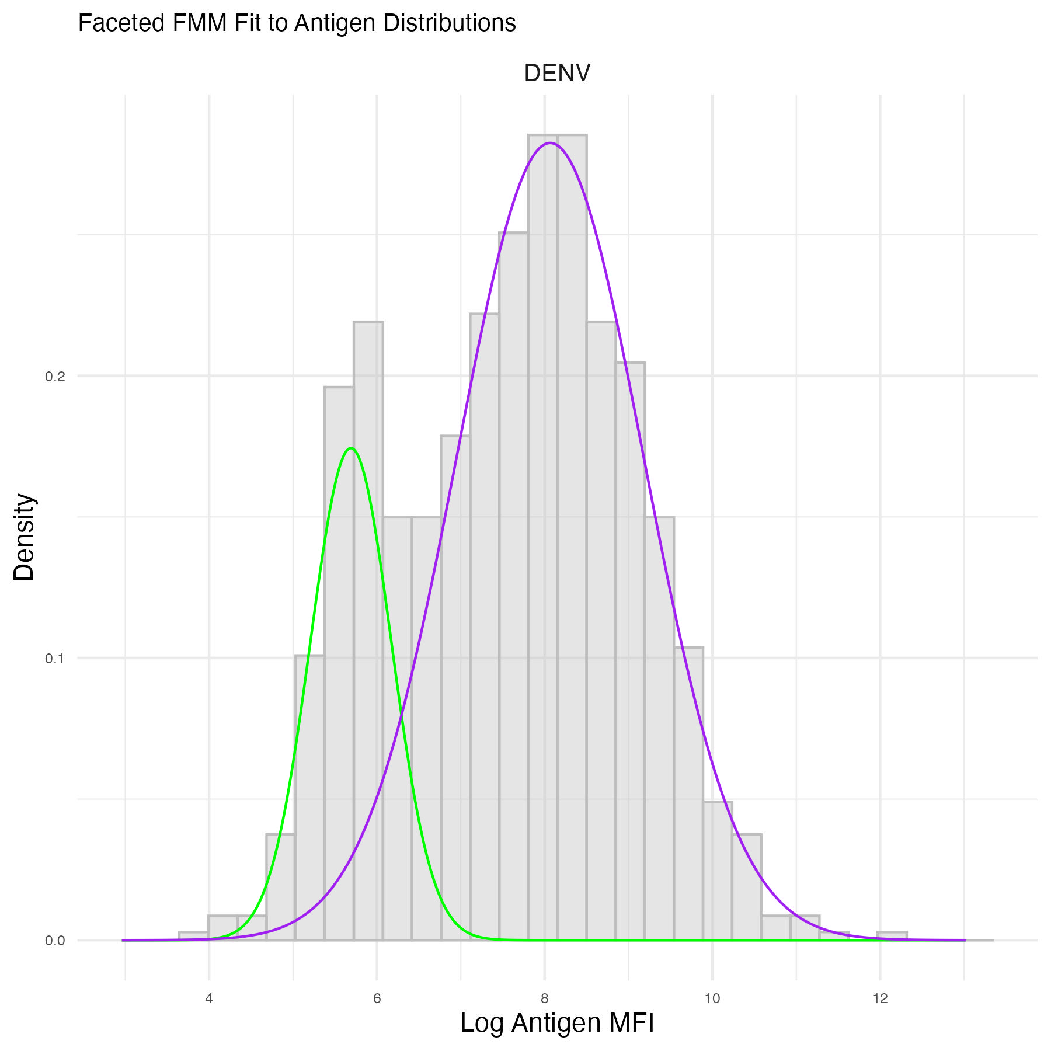
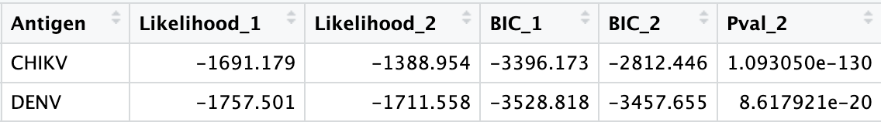
Mixture models
Statistics also show that 2 components fit these distributions better than 1 component
Notes:
The statistics show that bimodal distributions fit

Slide 45
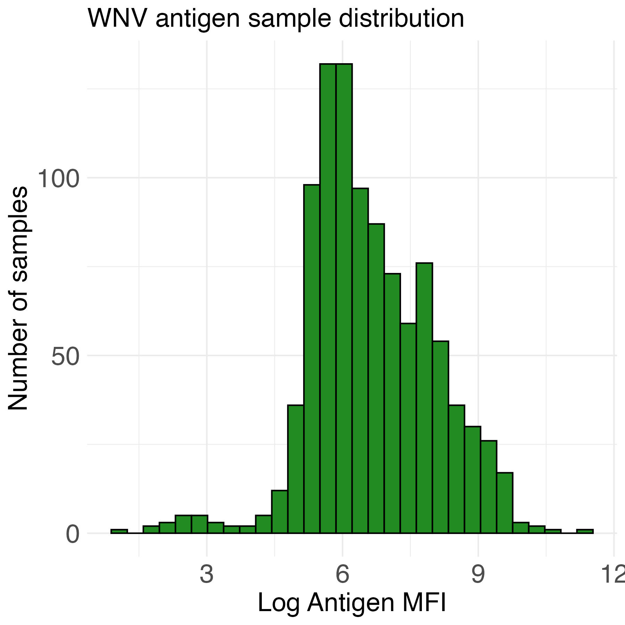
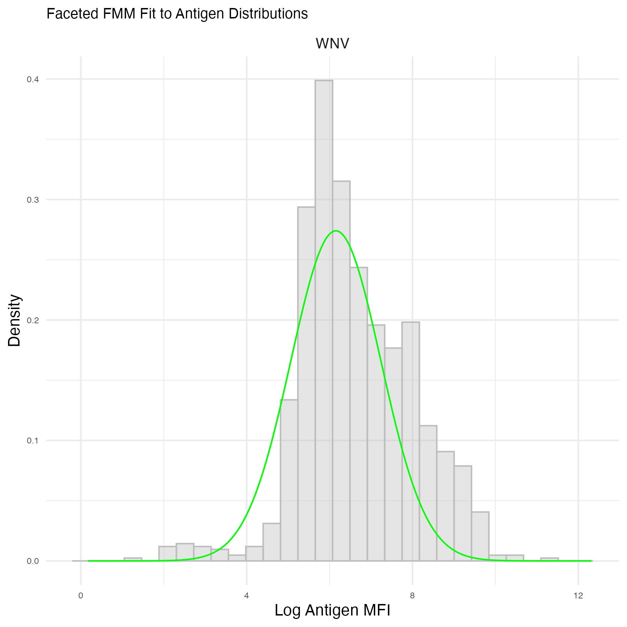
Mixture models
Some antigen distributions like West Nile Virus are not as good:
One component is best fit
Notes:
Distribution is not bimodal. Bimodal distributions are best for FMM

Slide 46
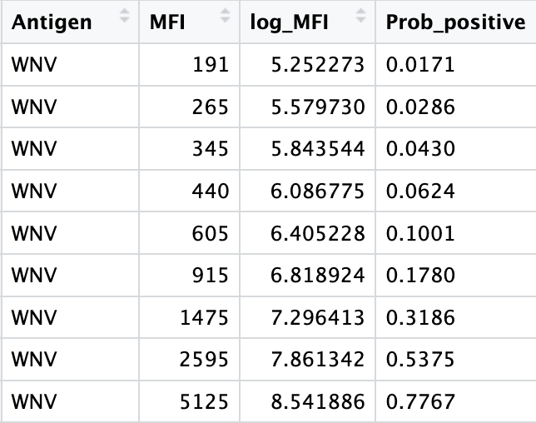
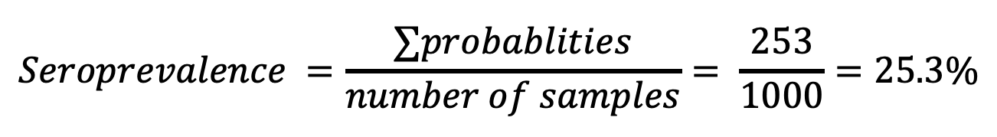
Mixture models
Unlike other methods, this method doesn’t calculate a cutoff
Instead, it calculates the probability of each sample being seropositive
Seroprevalence equals the sum of the individual-level probabilities of being seropositive
$$Seroprevalence =\frac{∑probablities}{number of samples}= \frac{253}{1000}=25.3\%$$

Slide 47
Conclusion
Methods to determine seropositivity come with different assumptions, which are important to understand.
The method you choose will depend on your study and the particular antigen(s), in addition to controls available, and sample and control distributions.

